Slide 1
Telemetry: Schema and Experiment
Last modified: Sep 20, 2017

Slide 2
Content:
Change Logs
Design Purpose and Target Users
DB Design and Implementation
UI
Code Base

Slide 3
Content:
Change Log
Major Version | Minor Version | Change Summary | Commit Date | Devs
0 | .0 | Beta version. Overall Flow in function | Sept 18, 2017 | royma

Slide 4
Content:
Design Purpose and Target Users
Design Purpose
In a fast pace development environment, engineering agility should be fully supported by tracking/alerting engineering derivatives, e.g., telemetries, customer feedbacks etc.
Other than supporting engineering activities, schema changes can be impactful to downstream analytical activities
Target Users:
Engineering functionalities
Analytical functionalities

Slide 5
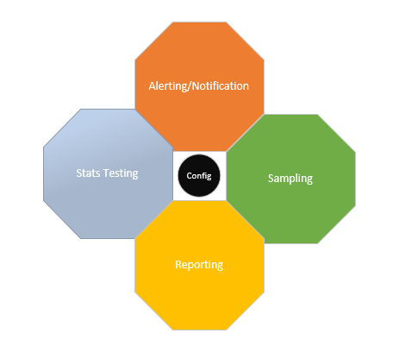
Content:
DB Design and Implementation
DB Design
In general, the database is designed to fit for rapid processing rather than on-line data integrity validation. Yet, off-line process is deployed to ensure data quality.
Database object naming convention:
4 key functionalities:
Alerting/Notification
Stats Testing
Sampling
Reporting
All of them are driven by configuration which is shared across all these functionalities

Slide 6

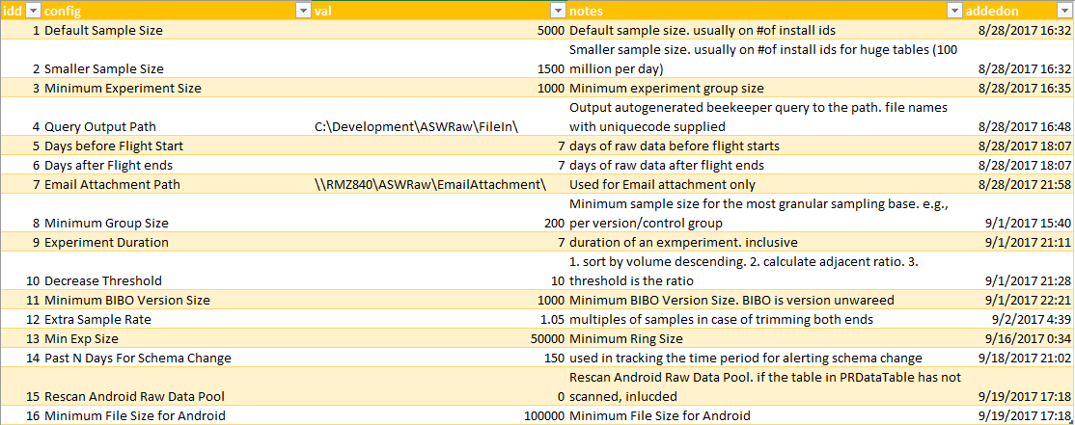
Content:
DB Design and Implementation
DB Design. Key Functionalities
Core: Config driven.
The following are the configurations used for across all functionalities

Slide 7
Content:
DB Design and Implementation
DB Design. Key Functionalities
Core: Config driven.
Meanings of these configurations are straight forward. One of the configurations, “Extra Sample Rate”, is used for over-sampling certain percentage to offset outliers that could be removed.

Slide 8
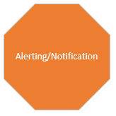
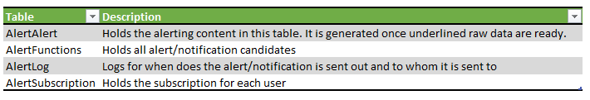
Content:
DB Design and Implementation
DB Design. Key Functionalities
Functionality: Alerting and Notifications
Alerting and Notification is used for allowing users from different business streams to subscribe information that they are interested in.
it has the following tables:

Slide 9
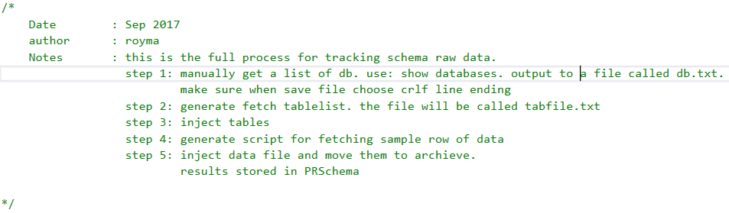
Content:
DB Design and Implementation
DB Design. Key Functionalities
Functionality: Alerting and Notifications
At the moment, we are scanning and injecting schema changes.
One alerting/notification will use one set of data pipe line.
For schema change alerting, one single stored procedure handles (manually copy and paste to beekeeper to run auto generated queries.)
p_Inspection_schemaFullProcess

Slide 10
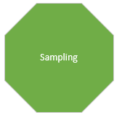
Content:
DB Design and Implementation
DB Design. Key Functionalities
Functionality: Sampling
Sampling functionality aims to automatically generate script to fetch raw data as soon as there are enough number of records for conducting statistics test. There are two sub-processes: a. volume monitoring process, and, b. script generation
(to be doc’ed)

Slide 11

Content:
DB Design and Implementation
DB Design. Key Functionalities
Functionality: Reporting
SQL Server Reporting Services is used for reporting
(to be doc’ed)

Slide 12
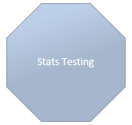
Content:
DB Design and Implementation
DB Design. Key Functionalities
Functionality: Testing
R services in SQL Server is used
(to be doc’ed)

Slide 13
Content:
UI
There are four set of Uis
Schema Change Alerting and Dashboard
Experiment Readiness
Tests Board
Configuration Setting

Slide 14
Content:
UI: Schema Change Alerting and Dashboard
There are four reports:
Entry point: AlertingSchemaDashboard http://rmz840/reports/report/RSinR/AlertingSchemaDashboard
To Subscribe alerts on schema change: Alert Subscription:
http://rmz840/ReportServer/Pages/ReportViewer.aspx?/RSinR/AlertSubscription
Details of schema change: AlertingSchemaDetail
http://rmz840/reports/report/RSinR/AlertingSchemaDetail
Please note Alert subscription and details and schema change are designed to be drilled through from Entry dashboard

Slide 15
Content:
UI: Schema Change Alerting and Dashboard – Backend objects
Backend Tables: Backend Stored Procedures:
Use SKSS;
Set rowcount 10;
select * from AlertAlert (nolock)
select * from AlertFunctions (nolock)
select * from AlertingDash (nolock)
select * from AlertLog (nolock)
select * from AlertSubscription (nolock)
Set rowcount 0
p_Alerting_bydbemail
p_Alerting_generatedata
p_Alerting_schemachange
p_Alerting_schemachange_functions
p_Alerting_schemachange_subscribeall
p_Alerting_schemaChangeDesktop
p_Alerting_schemaChangeDesktop_cutoff
p_Alerting_schemaChangeDesktop_dbs
p_Alerting_schemaChangeDesktopdash
p_Alerting_schemaChangeDetail

Slide 16
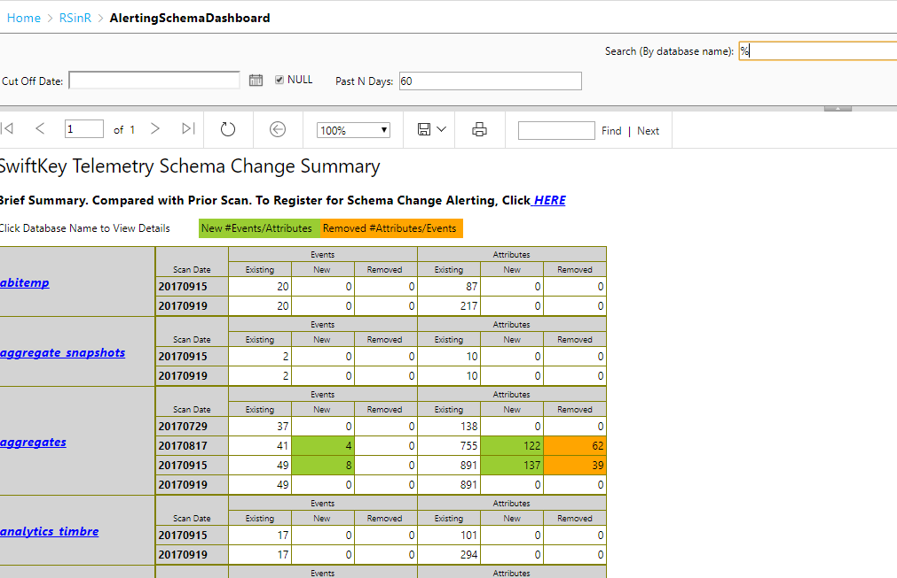
Content:
UI: Schema Change Alerting and Dashboard
Entry: AlertingSchemaDashboard
Looks like this:
Purpose and Target Users:
It’s purpose is to show schema changes.
Target users are engineering and telemetry data consumers.
Parameters:
Search: search by database name. wildcard is % sign
Cutoff Date: when null or blank, it is current date.
Past N Days: View Changes for past N days
Click Database Name will lead to AlertingSchemaDetail report With parameters.
Click HERE will lead AlertSubscription Report

Slide 17
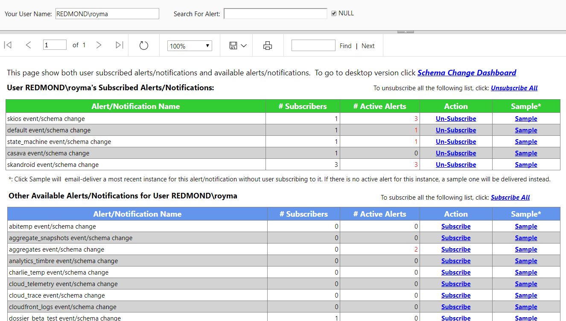
Content:
UI: Schema Change Alerting and Dashboard
Alert Subscription
Looks like this:
Purpose and Target Users:
It’s purpose is to allow users to subscribe interested databases’ schema change.
Target users are engineering and telemetry data consumers.
Parameters:
Search: search by database name. wildcard is % sign
One user can subscribe alerts for other user. Make sure either in domain\alias format or alias or full email address
There are five actions:
Unsubscribe all that meet search criteria
Unsubscribe one
Sample
Subscribe all that meet search criteria
Subscribe one
If there are active alerts, an email will be delivered to user immediately after subscribing

Slide 18
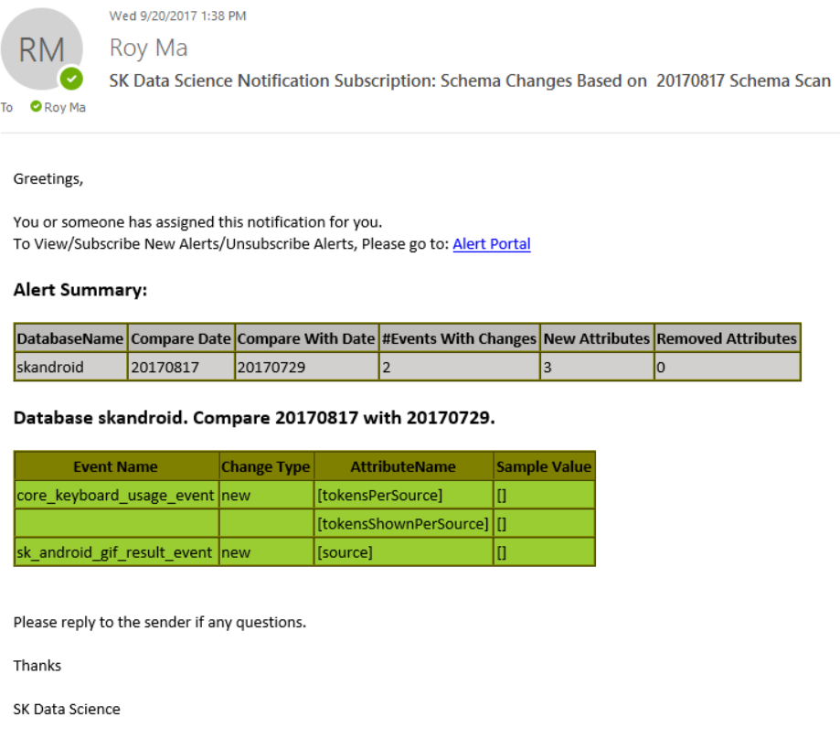
Content:
UI: Schema Change Alerting and Dashboard
Alert Subscription: Sample Email
A sample email may look like this:

Slide 19
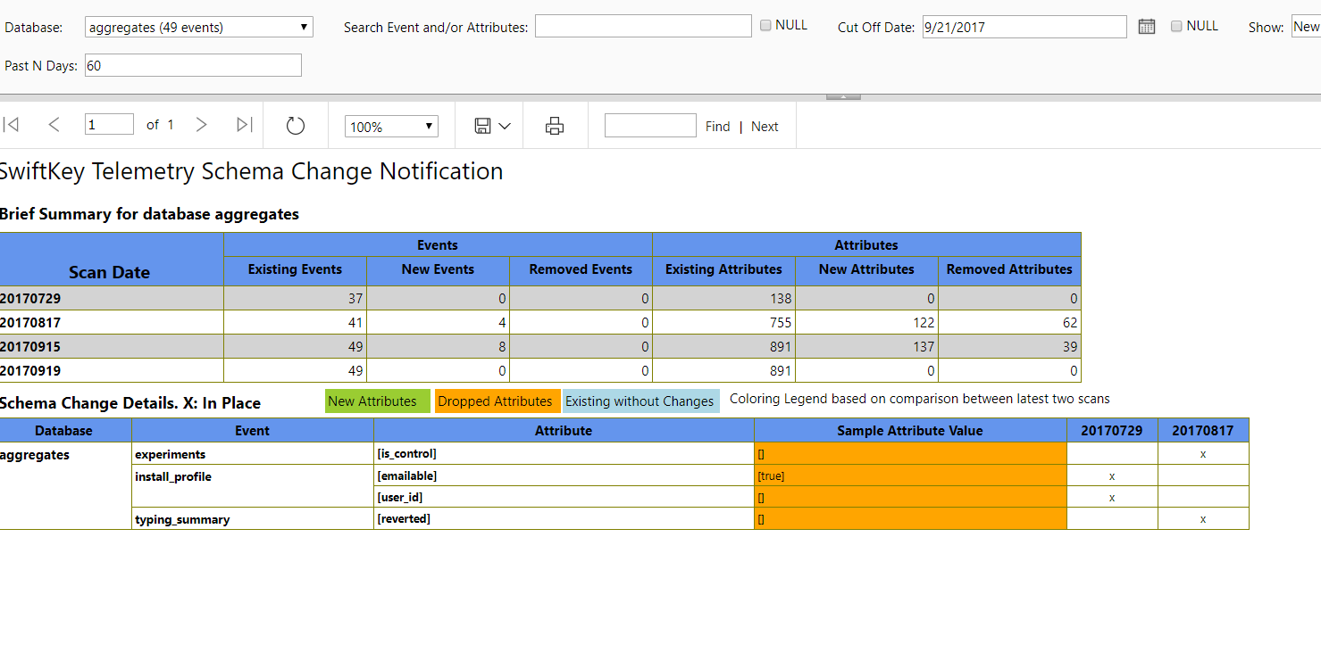
Content:
UI: Schema Change Alerting and Dashboard
Details of Schema Change
Looks like this:
Purpose and Target Users:
It’s purpose is to show detailed changes to the attribute level.
Target users are engineering and telemetry data consumers.
Parameters:
Search: by event name and/or attribute
Cutoff date: when null, default to current date
Show: new and/or removed and/or all
Past N days: changes during this period

